Slide 1


SMART INDIA HACKATHON 2020
PROBLEM STATEMENT- Detection of Child Predators/ Cyber Harassers on Social Media
PROBLEM ID- RK307
MINISTRY/ ORGANISATION- Bureau of Police Research & Development
DOMAIN- Security and Surveillance

Slide 2

Madras Institute Of Technology Campus
Anna University
PREVENTION OF EMOTIONAL ENTRAPMENT OF GIRLS ON SOCIAL MEDIA PLATFORMS
Team SPHYNX
Members-
Kirupalini S
Gowri S Swetha S
Amruthavarshini R
Gayathri Rengarajan
Aditi Baskar
Mentors-
Dr. D Sangeetha (Academia)
Vignesh Sankaran (Industry- Pentafox)

Slide 3
NEXT STEP
In the first presentation the workflow, accuracy and implementation of our proposed solution was covered.
Today we converted our chat room code to a dynamic format and also modified the alert mechanism wherein multiple parties can be informed without spam.
We have now begun work on the milestones namely-
Anonymised data
Identify chat bots
End-to-end encryption

Slide 4
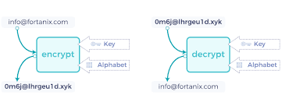
Anonymised data
1. Format Preserving Encryption (FPE)-
The data such as user name, can be encrypted with a cryptographic algorithm and can be decrypted in the reverse process to get back the data for the alert mechanism.

Slide 5
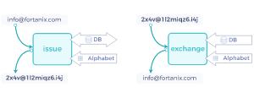
2. Tokenisation-
The data fields like name will be assigned a random string which has no important value so as to mask such sensitive information. The randomised tokens along with the corresponding words or data field entries will be stored in our backend.
Our main aim is to alert the authorities with sufficient information. At the same time, privacy of the user is also very important. So, we have narrowed it down to these two methods as the original information can be recovered easily.

Slide 6
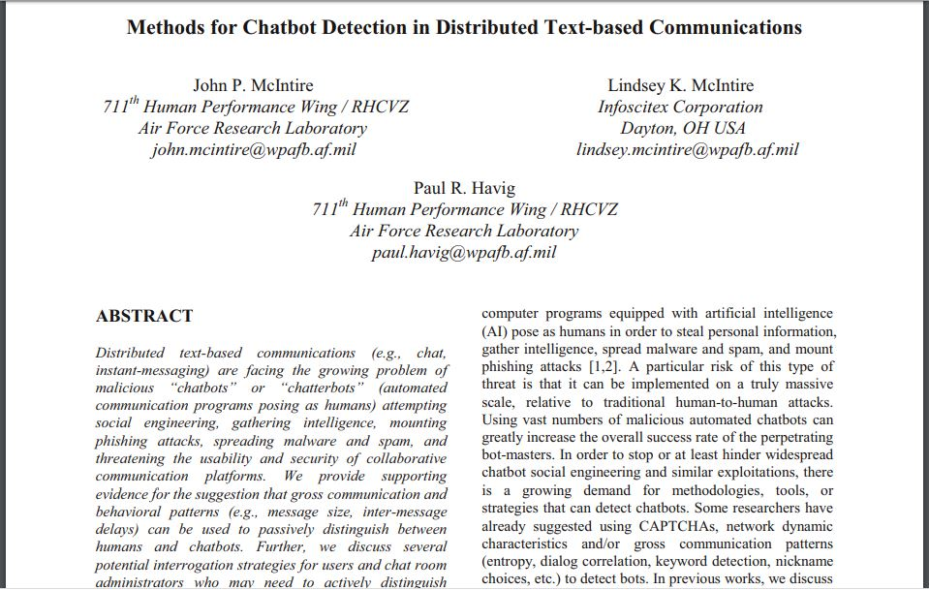
CHAT BOT DETECTION
Message Sizes
Inter Message Delays
Hints for good questions, games and probes
Repetition
Keyword Targeting
Evasiveness
SOURCE : IEEE Paper by John P. McIntire, Lindsey K. McIntire and Paul R. Havig

Slide 7
Some of the features we have come up with to detect bots-
Obsessed with a particular topic.
Responds quickly and does not speak naturally as human does.
Multilingual responses possible.
User profile lacks information about a real person.
Responds repetitively to onomatopoeic messages and emotional messages.
Running a reverse image search on their profile picture to see if they are using a photo of someone else taken off the web.
The username may have a generic name followed by numbers, or it may just be a random sequence of numbers.

Slide 8
END-TO-END ENCRYPTION
The biggest benefit of this encryption is that users have the ability to exercise their right to free speech without any problems.
However, it becomes very difficult for law enforcement agencies to monitor and detect criminal activities on such platforms.
Hacking into such an encryption is extremely difficult since the messages are encrypted on the local device. Metadata provided by the social media is not sufficient to track such activities. Since there is no agreement between social media platforms and the law enforcement, it is very difficult for us to break this encryption.
The possible solution may be to monitor the conversations from the users’ local device.

Slide 9
THANK YOU

